Slide 1









STREAMLIT WEB APP - BREAST CANCER CLASSIFICATION
USING NEURAL NETWORKS
ENDAH RAKHMAWATI

Slide 2





TOOLS
GOALS
Our goal is to demonstrate how we achieve an impressive accuracy in classifying breast cancer cases whether BENIGN or MALIGNANT based on comprehensive data analysis and neural networks modeling techniques.

Slide 3
DATASET OVERVIEW
Source : Breast Cancer Wisconsin (Diagnostic) Dataset
Description:
Features computed from digitized FNA images of breast masses, describing characteristics of cell nuclei.
Based on 3-dimensional space described in: K. P. Bennett and O. L. Mangasarian (1992).
Attribute Information:
ID number
Diagnosis: (M = malignant, B = benign)
Mean features:
a) Radius
b) Texture
c) Perimeter
d) Area
e) Smoothness
f) Compactness
g) Concavity
h) Concave points
i) Symmetry
j) Fractal dimension
Standard Error (se) features corresponding to the above 10 mean features.
Worst (Largest) features corresponding to the above 10 mean features.

Slide 4
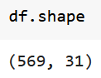

Consists of 569 rows, 31 columns
01.
Categorical variable: 'diagnosis'
Numerical variables: The rest of the columns.
EXPLORATORY DATASET
02.
Feature Values: Recoded with four significant digits.
Missing Values: None reported.
Class Distribution:
357 benign cases
212 malignant cases
03.

Slide 5
DATA PREPROCESSING
Data cleaning
CORRELATION VARIABLES
OUTLIER HANDLING
SPLITTING DATA
remove spacing in some columns name
encode 'diagnosis' values with LabelEncoding
change the diagnosis label to target label
After making heatmap of pearson correlation, we can see some of feautres have the absolute correlated each other.
There are several intercorrelated variables or redundant features identified in the dataset that should be considered for deletion.
Almost all features are recognized having skewed distribution, so we can identify the outliers and drop its for each index which have the outlier. We have chosen to proceed with the results from the Z-score method with the threshold is 3.
Now we have filtered features and reducing some outliers for each feature, so the dimensions of the dataset have changed.
Before training the dataset we need to split it into train data 80% and test data 20%.

Slide 6
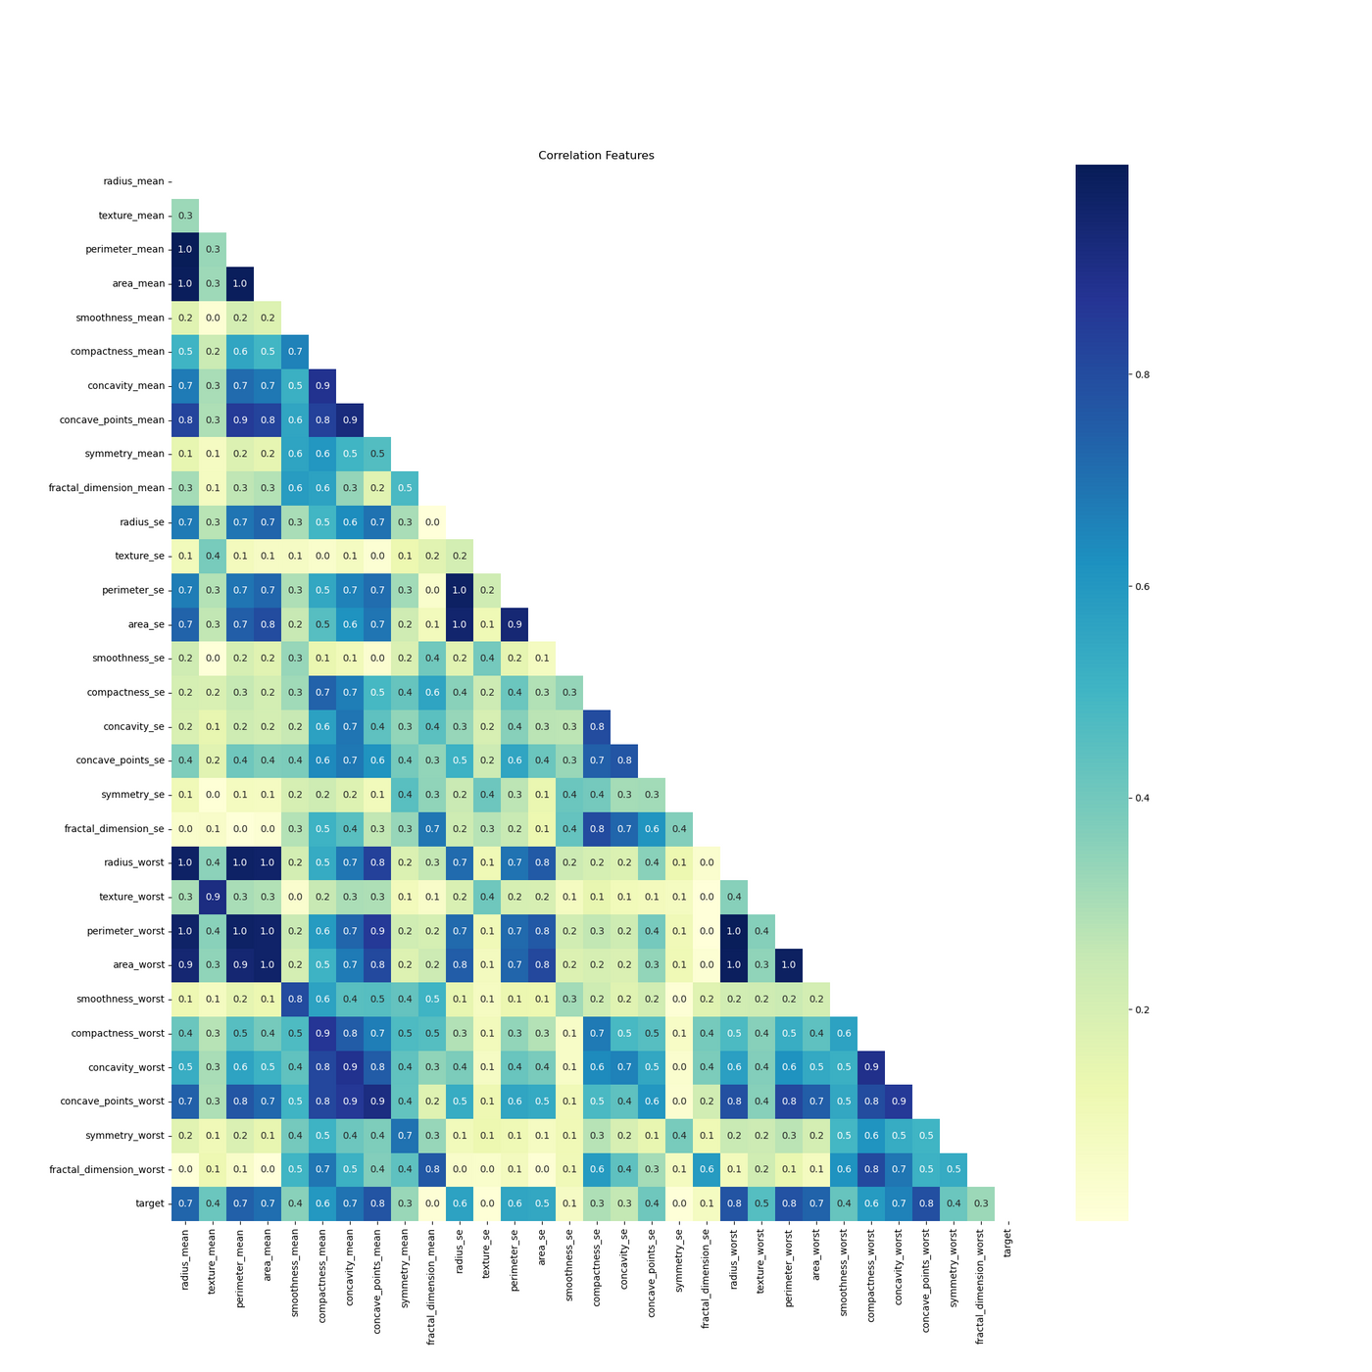
VISUALIZATION OF CORRELATION FEATURES

Slide 7
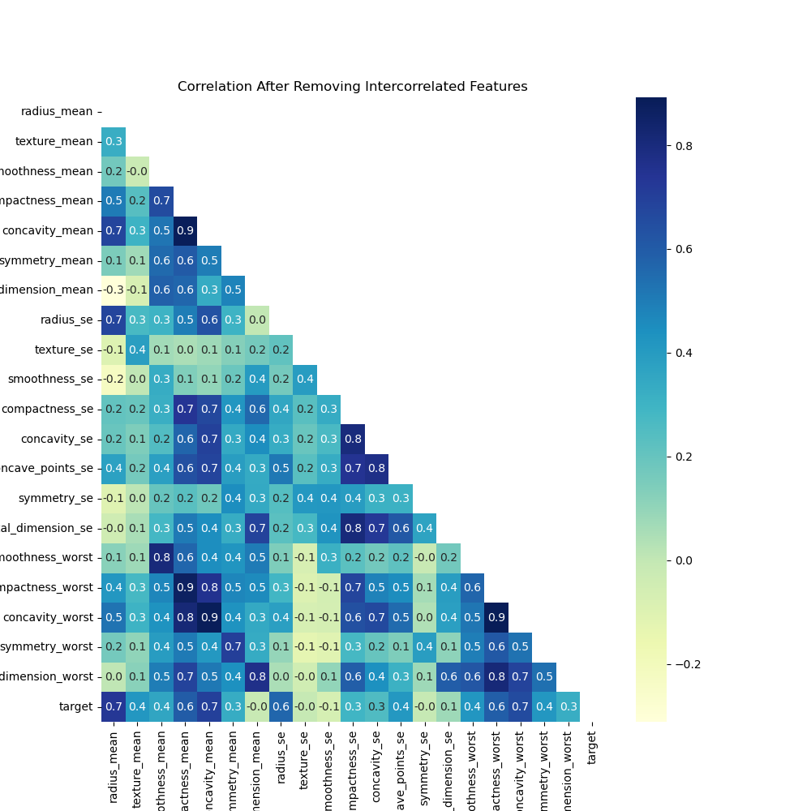
VISUALIZATION OF FILTERED FEATURES

Slide 8
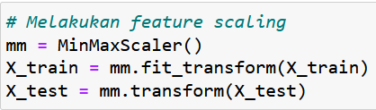
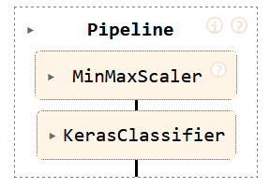
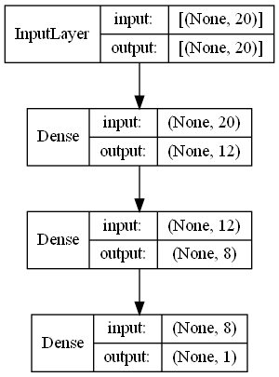
WITHOUT PIPELINE
CREATING PIPELINE
After that train X_train dan y_train data using the model and validation the accuracy using X_test and y_test at once.
MODELING NEURAL NETWORKS USING KERAS
The last step is KerasClassifier model. Set the parameters equal with Keras manual model.
Epoch = 60
Input shape = 20 features
2 Hidden layer = 12 neurons (activation : relu) , 8 neurons (activation : relu)
Output layer = 1 neuron (activation : sigmoid)
Batch size = 30

Slide 9
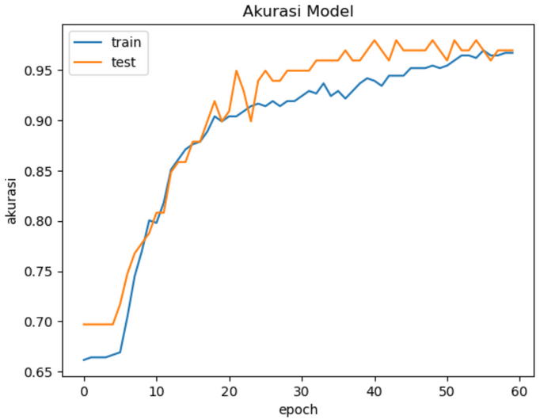
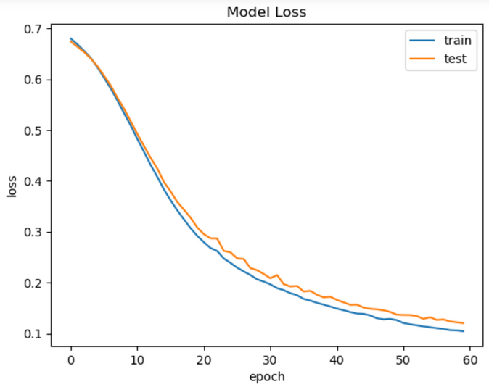
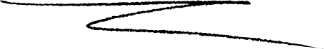
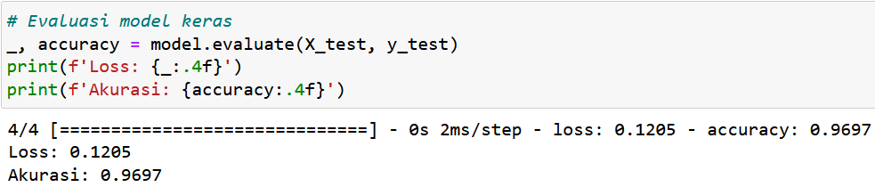
EVALUATION MODEL WITHOUT PIPELINE
ACCURACY : 96,97%

Slide 10
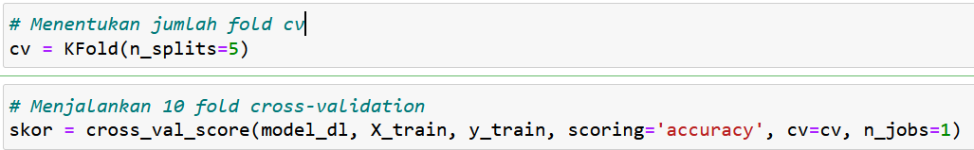
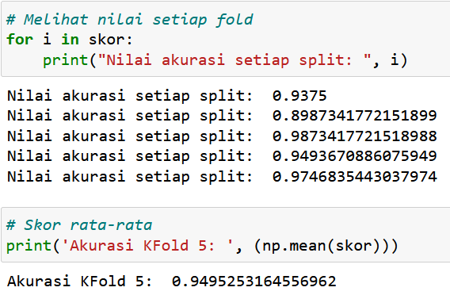
EVALUATION MODEL WITH PIPELINE
ACCURACY - CV KFOLD 5 : 94,95%

Slide 11
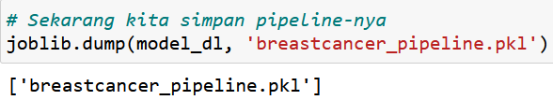
SAVE THE MODEL AND THE PIPELINE
MODEL_BC_KERAS.H5
BREASTCANCER_PIPELINE.PKL
AND THEN LOAD THEM ALL TO DEVELOP THE MODEL INTO STREAMLIT WEB APP

Slide 12
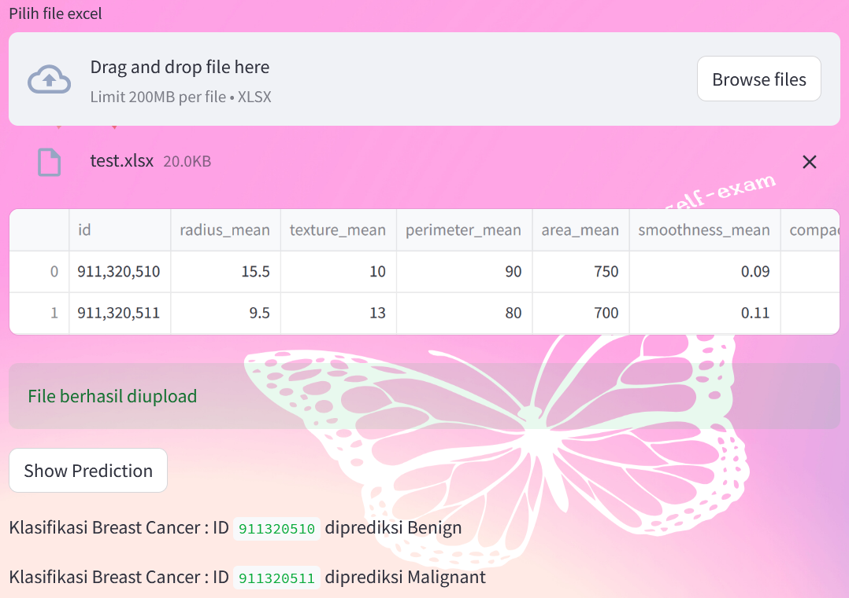
STREAMLIT WEB APP - INPUT FROM EXCEL

Slide 13
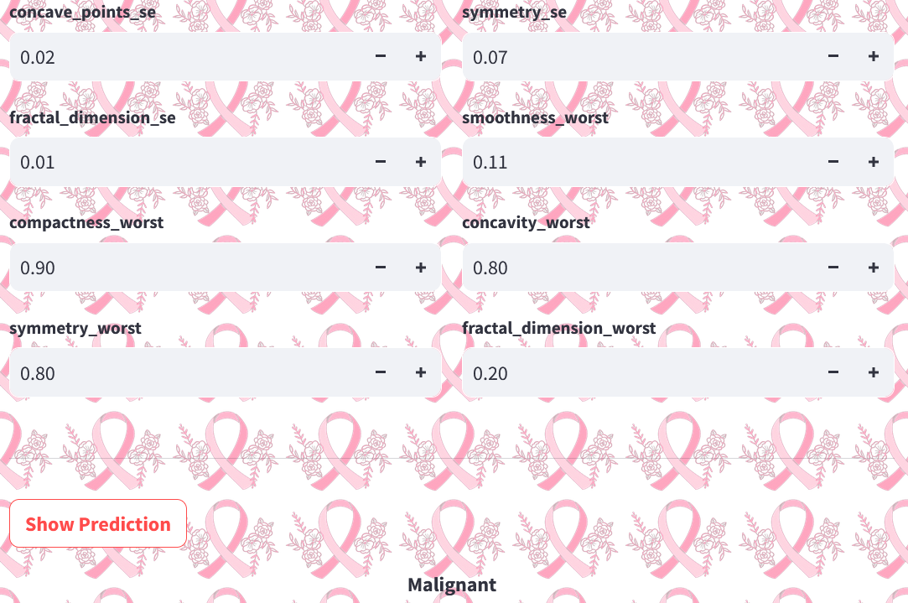
STREAMLIT WEB APP - INPUT MANUAL

Slide 14
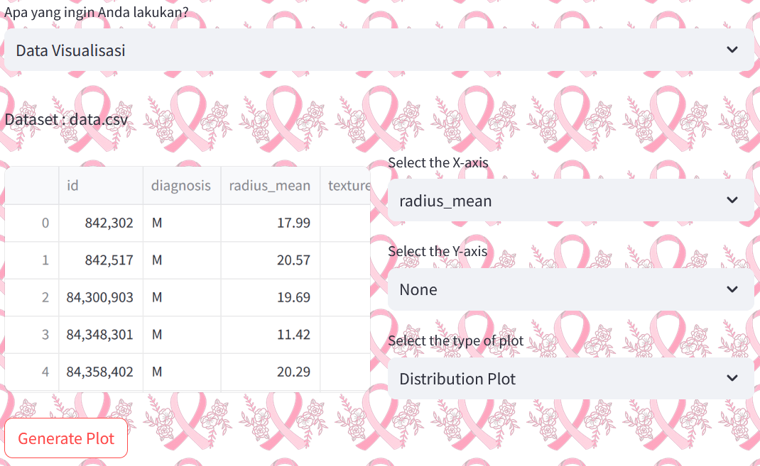
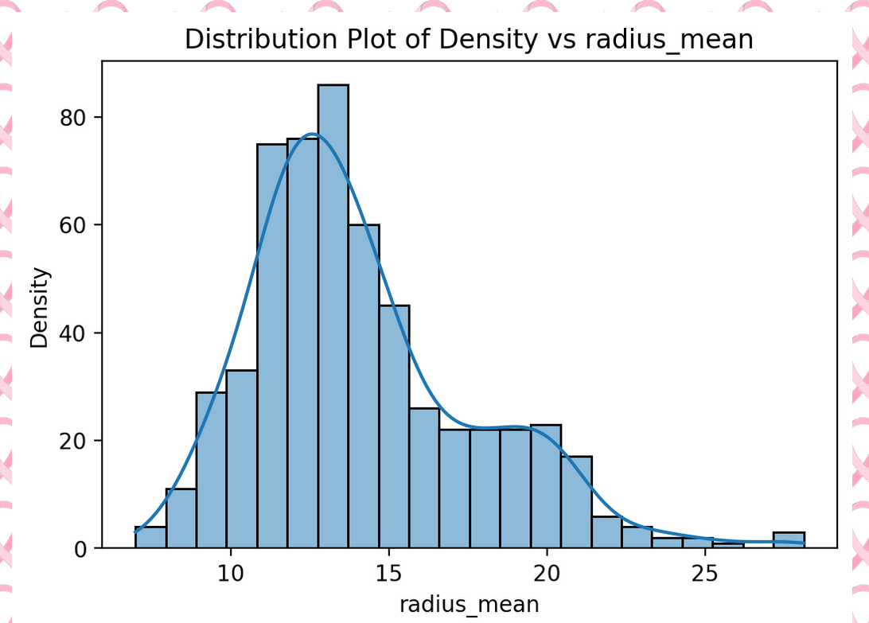
STREAMLIT WEB APP - VISUALIZATION

Slide 15
CONNECT WITH ME :
ENDAHEN12@GMAIL.COM
WWW.LINKEDIN.COM/IN/ENDAHRAKHMAWATI

